Slide 1


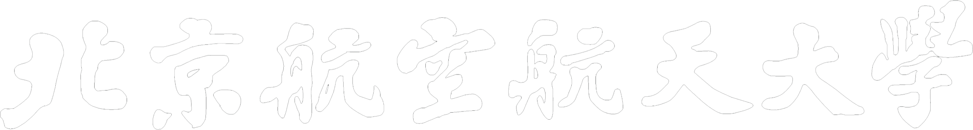
Heterogeneous Graph Neural Network with Hypernetworks for Knowledge Graph Embedding
Beihang University
Xiyang Liu¹, Tong Zhu¹, Huobin Tan¹, and Richong Zhang²
¹School of Software
²SKLSDE, School of Computer Science and Engineering

Slide 2
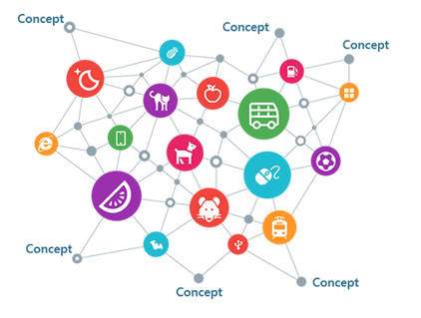



Introduction
Knowledge Graph
Completion
Knowledge Graph Embedding (KGE)
Projects entities and relations
into a low-dimensional vector space
Question Answering
Recommendation System
Sematic Search

Slide 3
Introduction
A Knowledge Graph (KG) is a relational graph
Knowledge Graph Embedding (KGE)
The Lord of the Rings
screenwriter_of
acted_in
Fran Walsh
Ian McKellen
Embedding
screenwriter_of
directed
married
Peter Jackson
A typical and natural task to evaluate the learned KGE is predicting missing links in KGs:
Input: (subject entity, relation, ?), (s, r, ?) for short
Model:
Learning KGE
Estimating the possibility score of (s, r, o_{candidate}) using KGE
Output: argmax(score(s, r, o_{candidate}))

Slide 4
Existing KGE models
Shallow Models
Translation based, such as TransE, TransR, TransH
Tensor factorization based, such as DistMult, ComplEx
Cons: Limited expressiveness and large embedding dimension
Deep Models
Conventional neural network based, such as MLP, NTN
Convolutional neural networks (CNN) based, such as ConvE, ConvR, ConvKB
Recurrent neural network (RNN) based, such as RSN, R-MeN
Cons: Unable to learn the graph structural information adequately

Slide 5
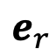
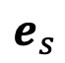
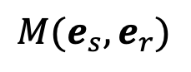
Existing GNN-KGE models
The general framework for GNNs to learn KGE
Cons:
Learning relation embeddings in the lower-levels layers may constrain the extraction of relational semantics
$$e_{s}$$
$$e_{r}$$
Subtraction: VR-GCN, TransGCN
Concatenation: KBGAT
Circular correlation: COMPGCN
CNN-based: ReInceptionE
$$M(e_{s},e_{r})$$
Relations are important, e.g. the average occurrence in FB15k-237:
Entity 37.3
Relation 1148
Graph Convolution Operation
We consider building a HGNN that learns relational representations in higher-level layers

Slide 6
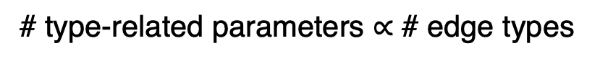
A challenge in designing HGNN for KG
The most commonly applied mechanism for HGNNs to model the heterogeneity is keeping separate parameters for each node or edge type.
Most HGNNs are presented to handle graphs with few edge types:
Graph (# edge types) | Processed by HGNN
20NG (4), MR (4), R8 (4), R52(4) | HeteGCN
DBLP (4), ACM (4), Yelp (6) | HGSL
Amazon (2), Twitter (4), Healthcare (4) | SliCE
ACM (2), IMDB (2), Reuters (4) | MR-GCN
IMDB (2), DBLP (3), Last.fm (3) | MAGNN
# type-related parameters $∝$ # edge types
But a KG may contain hundreds and even thousands of relations!

Slide 7
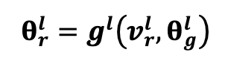
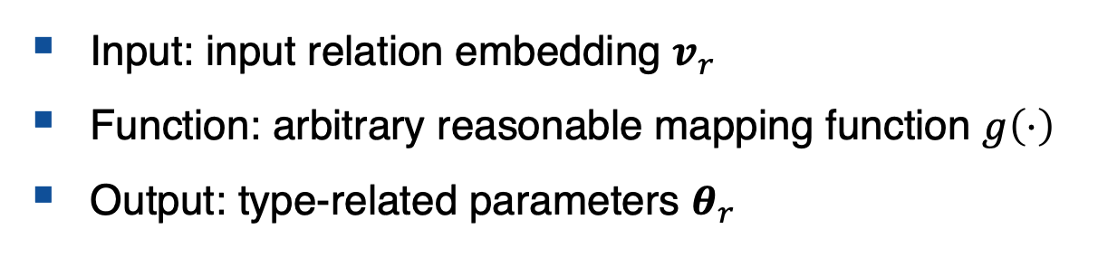
Our Approach
Problem
How to effectively capture the high heterogeneity of relations while controlling the number of type-related parameters?
We introduce external networks called hypernetworks into HGNN
Input: input relation embedding $v_{r}$
Function: arbitrary reasonable mapping function $g\left(⋅\right)$
Output: type-related parameters $θ_{r}$
Message Construction
Message Aggregation
We follow the general Message Passing Framework

Slide 8
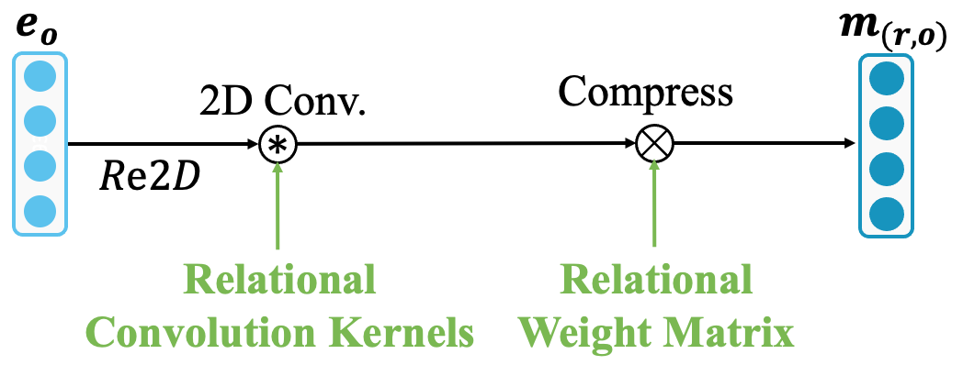
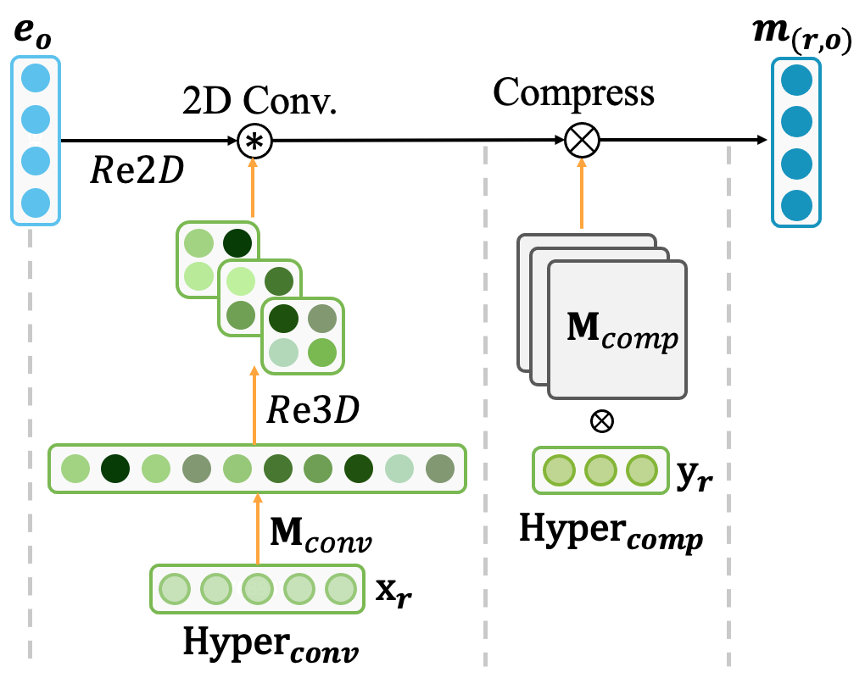
Using Hypernetworks for Message Construction
Encoding a single adjacent edge (s, r, o)
Using hypernetworks
Similar to ConvR, but with additional relation-specific weight matrix

Slide 9
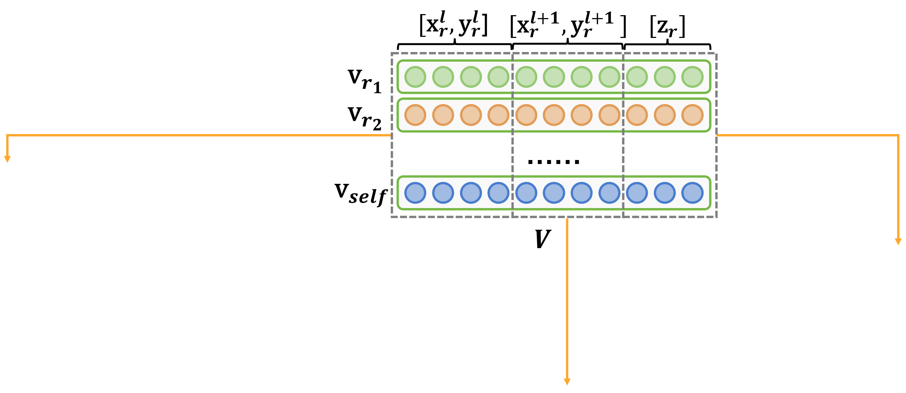
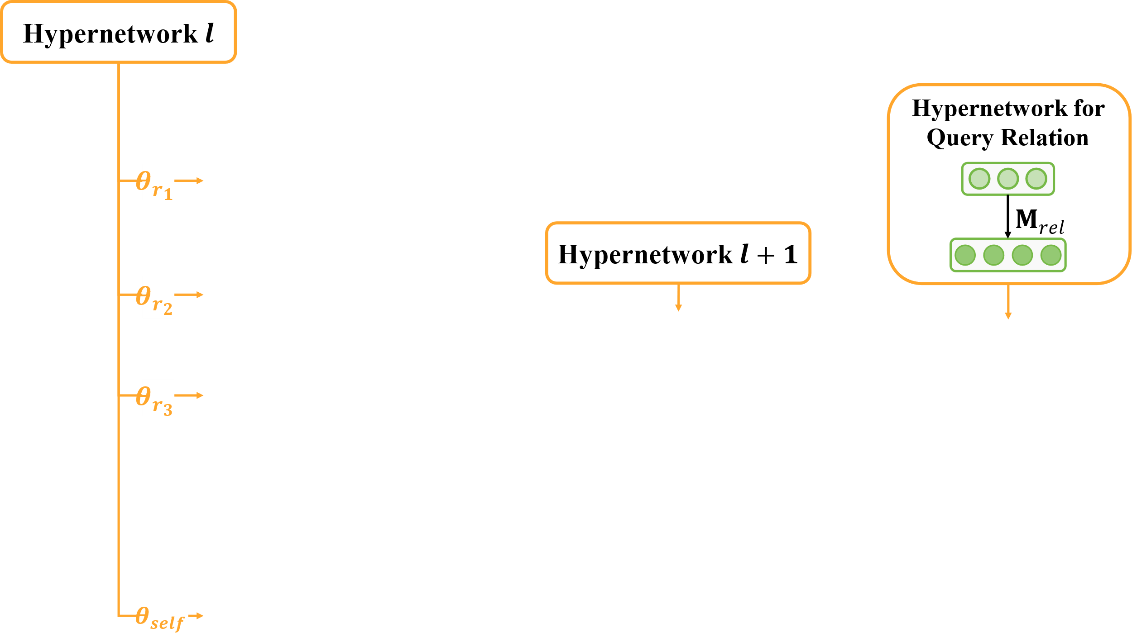
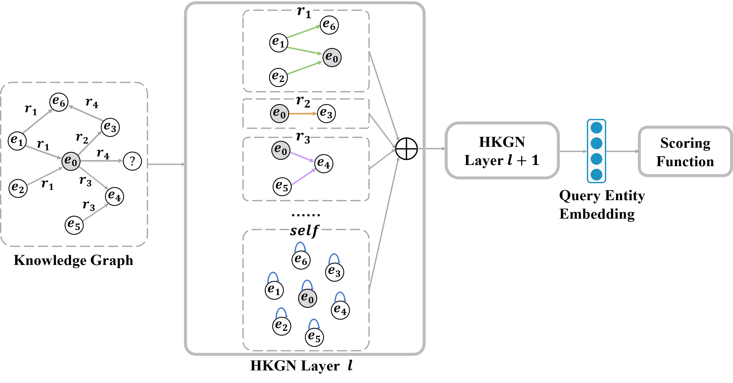
Using Hypernetworks for Message Aggregation
Encoding the local graph structure

Slide 10
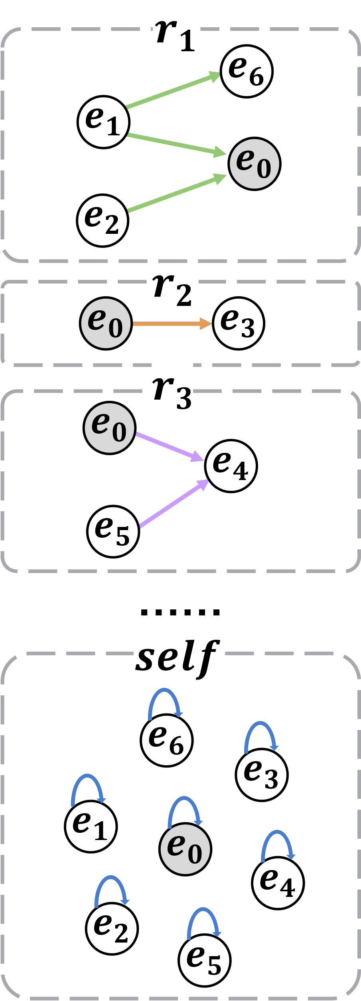
Training Strategy
Two training strategies to make a trade-off between GPU memory footprints and learning time:
Parallel:
Higher memory consumption
Less training time
Single-relational graphs
Iterative:
Lower memory consumption
Longer training time

Slide 11
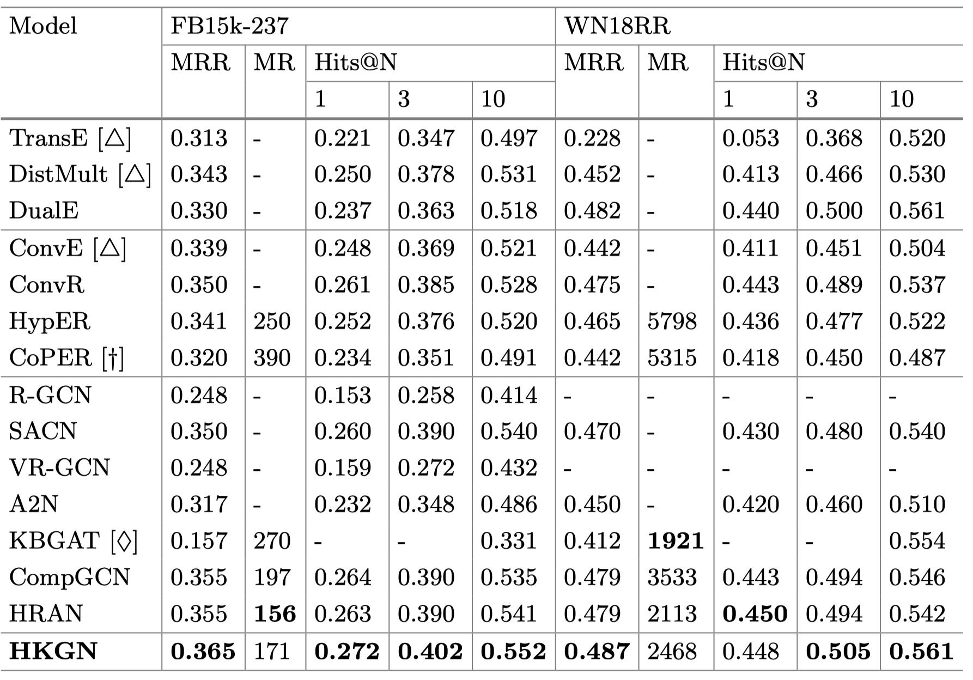
Experimental Results
Link Prediction Results:

Slide 12
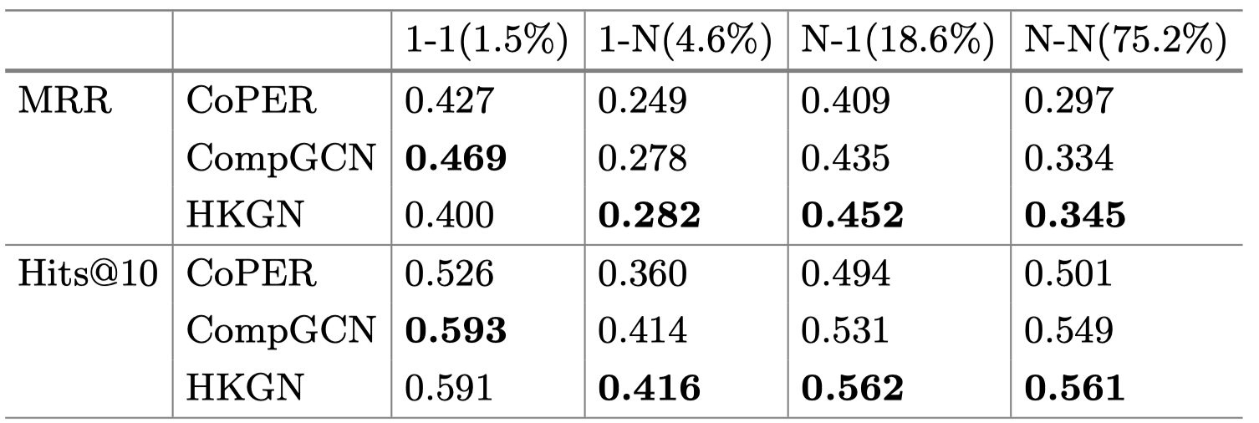
Link Predictions Results by Relation Category
Following TransH (Wang et al.), we divided relations into four classes: 1-to-1, 1-to-N, N-to-1, and N-to-N
FB15k-237
HKGN performs better for complex relations including 1-N, N-1 and N-N

Slide 13
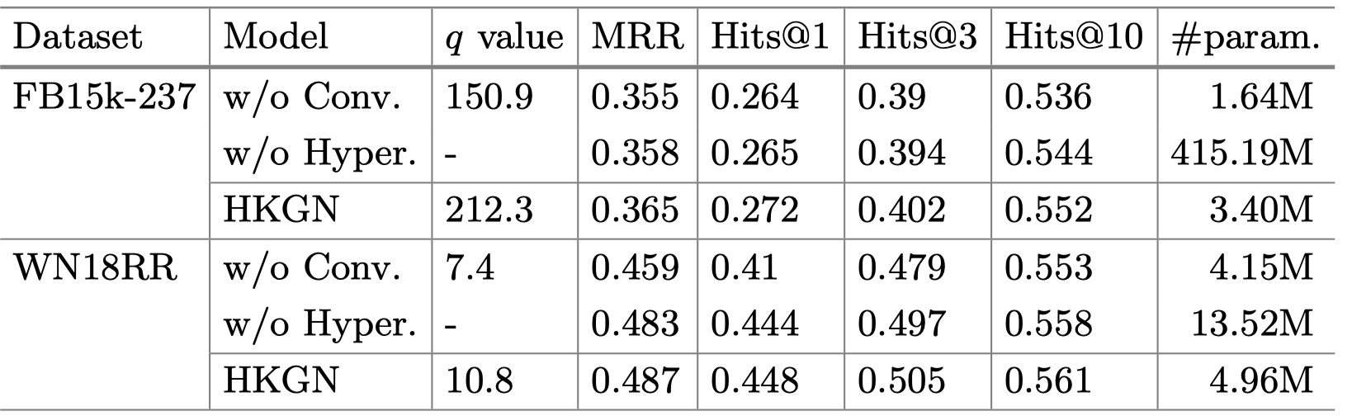
Ablation Study
Conv. denotes the relational convolution
Hyper. denotes the hypernetworks
Removing relational convolution leads to all metrics (MRR, Hits@1, 3, and 10) degradation.
Eliminating hypernetworks leads to 122x (FB15k-237) and 2.7x (WN18RR) more parameters and simultaneously worse performance.

Slide 14
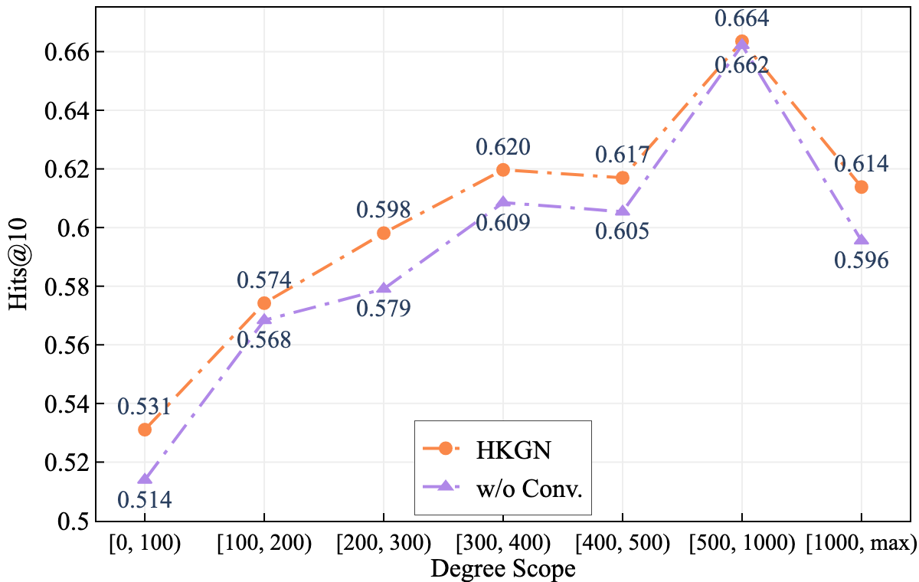
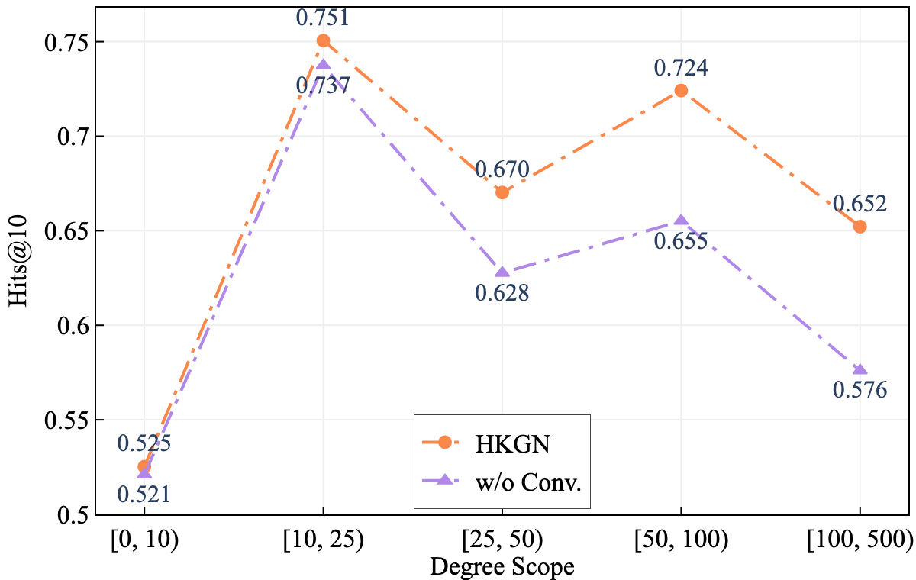
Effect of Relational Convolution
How the prediction results of entities with different degrees can be affected by the relational convolution.
FB15k-237
WN18RR

Slide 15
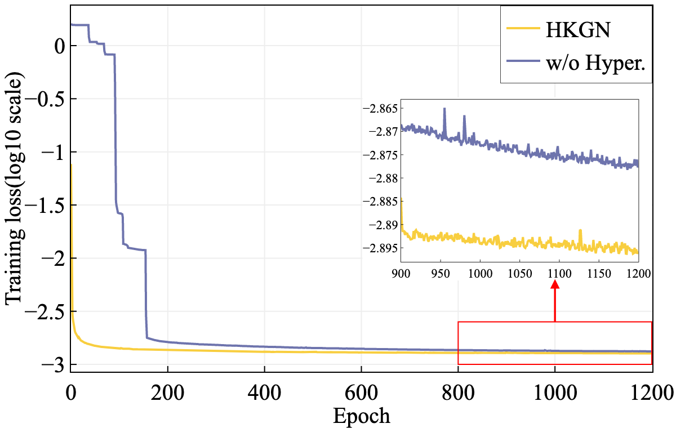
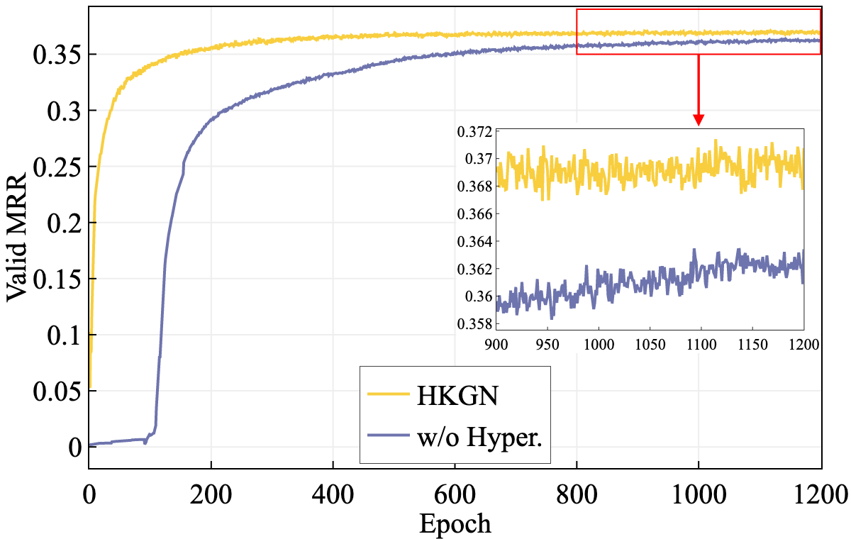
Effect of Hypernetworks
The impact of reducing numerous trainable (may be meaningless) parameters on FB15k-237.
Training loss
MRR on valid set

Slide 16
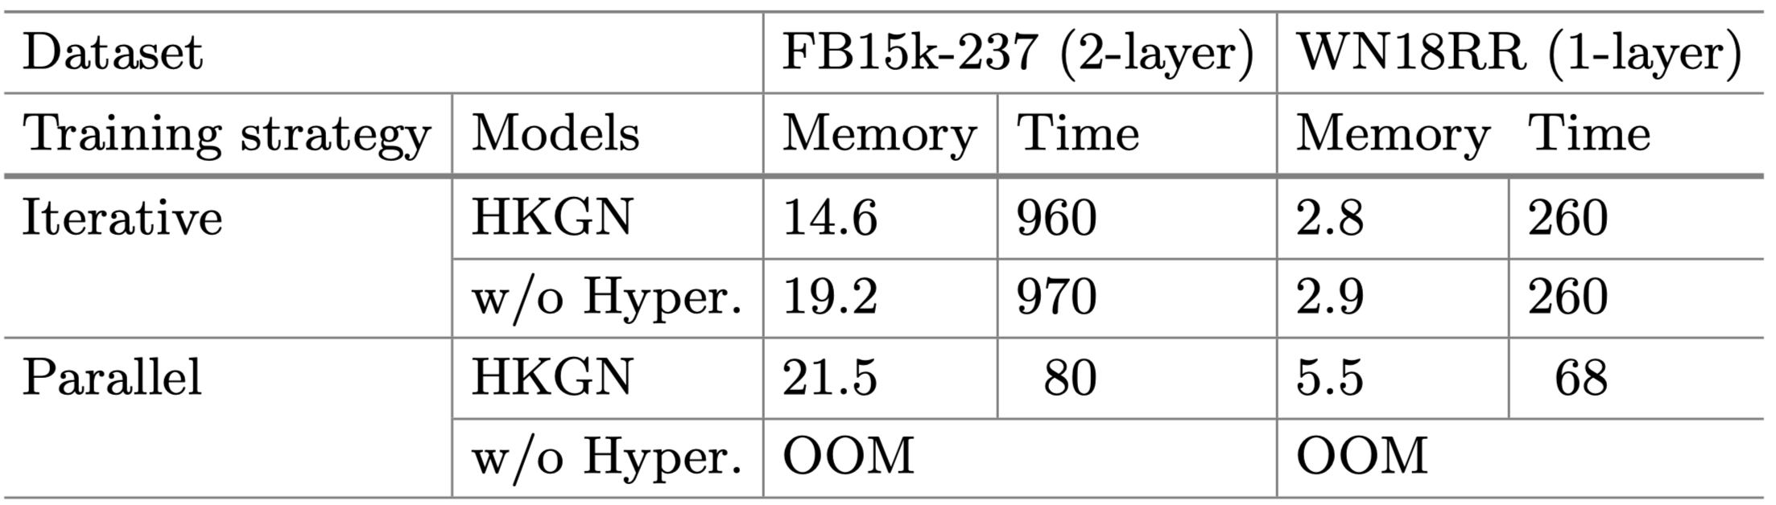
Effect of Hypernetworks
The impact of utilizing hypernetworks on GPU memory footprints (in GB) and training time (in seconds per epoch).
OOM:
Out of Memory
HKGN achieves relatively lower GPU memory allocation without increasing the training time.

Slide 17
Conclusion
Contribution
We introduce hypernetworks into HGNN, based on which we build a HKGN by modeling relational semantics on higher-level layers.
We empirical demonstrate the effect of utilizing hypernetworks.
Code
GitHub: https://github.com/liuxiyang641/HKGN
Contact
Email: thbin@buaa.edu.cn
Thank you for attention!

